Slide 1
Goal–Question–Metric
SOFTWARE ARCHITECTURE · MEASUREMENT
Measuring quality attributes with a purpose: a refresher for the lecturer, plus three workshop slides
Slides 2–9: refresher · Slides 10–12: workshop
Notes:
Slides 2 to 9 are for your own preparation. Slides 10 to 12 are the ones to show participants; slide 12 is meant to stay on screen during group work.

Slide 2
Measure because of a goal, not because data exists
REFRESHER · THE IDEA
GQM starts from what you want to know and derives only the measurements needed to answer it. Everything collected can be traced back to a goal.
Define top-down
Interpret bottom-up
Origin
Goal → questions → metrics. Nothing is measured without a question that needs it.
Data answers questions; the answers tell you whether, and how far, the goal is met.
Basili & Weiss, NASA Software Engineering Lab (1984); formalised by Basili, Caldiera & Rombach (1994).
GQM refresher · 2
Notes:
Core message: measurement programmes fail when they collect whatever is easy and hope it means something. GQM forces the reasoning chain to be explicit: a metric exists only because a question needs it, and a question exists only because a goal needs it. The same chain is then used in reverse to interpret the data.

Slide 3
Three levels, one hierarchy
REFRESHER · STRUCTURE
Goal
What you want to achieve or understand: an object, a purpose, a quality focus, a viewpoint and a context.
CONCEPTUAL
Question
How the goal will be assessed: questions that characterise the object with respect to the quality focus.
OPERATIONAL
Metric
Data that answers a question. Objective (measured from the system) or subjective (depends on who is asked).
QUANTITATIVE
Many-to-many: one question usually needs several metrics, and one metric can serve several questions.
GQM refresher · 3
Notes:
The result of applying GQM is a measurement model: a tree (really a DAG) per goal. Objective metrics: latency, error rate, lines of code, number of dependencies. Subjective metrics: developer-rated ease of change, user satisfaction. Both are legitimate; subjective ones are often the cheapest way to get a first answer.

Slide 4
A goal is written with a template
REFRESHER · GOALS
Analyse [object] for the purpose of [purpose] with respect to [quality focus] from the viewpoint of [viewpoint] in the context of [context]
Facet | Typical values in architecture work
Object | System, component, interface, deployment, build pipeline
Purpose | Characterise, evaluate, predict, improve, control
Quality focus | Performance, availability, modifiability, security, cost
Viewpoint | End user, operator, developer, architect, product owner
Context | Peak load, team size, technology, phase of the project
GQM refresher · 4
Notes:
The viewpoint matters more than people expect: “performance” for an end user is response time, for an operator it is resource use, for a finance owner it is cost per transaction. Different viewpoints produce different questions from the same quality focus. In the workshop the NFR is the quality focus and the group’s system is the object.

Slide 5
Good questions, good metrics
REFRESHER · QUESTIONS AND METRICS
Questions
Metrics
Can be answered with data
Stay on the goal’s quality focus
Answer could change a decision
Three kinds: what is it like now (baseline), what affects it (model), did it get better (evaluation)
Precisely defined: unit, scale, how it is computed
Source and collection frequency named
Objective or subjective, chosen on purpose
Cost of collecting is known
Add a hypothesis: write down the value you expect before measuring. Without it you can’t tell whether a result is good or bad.
GQM refresher · 5
Notes:
Basili’s original guidance groups questions as: how to characterise the object (baseline), how to characterise the quality focus (what influences it), and how to evaluate the object against the focus. A good test for a question: if the answer came back surprising, would someone do something differently? If not, drop it. For metrics, the definition must be tight enough that two people would compute the same number.

Slide 6
Six steps: four to define, two to use
REFRESHER · PROCESS
1 · DEFINE
2 · DEFINE
3 · DEFINE
Set goals
Derive questions
Specify metrics
Few, explicit, written in the template.
What must we know to judge the goal?
Which data answers each question?
4 · DEFINE
5 · USE
6 · USE
Plan collection
Collect and validate
Analyse and feed back
Sources, tools, owners, frequency.
Check data quality while collecting.
Answer the questions, judge the goal, act.
GQM refresher · 6 · steps paraphrased from Basili’s GQM process
Notes:
The workshop covers steps 1 to 4 plus a selection step. Make clear to participants that steps 5 and 6 are where the value is realised: if nobody looks at the data and acts, the measurement was waste. The feedback step often refines the goal itself, so GQM is iterative.

Slide 7
The abstraction sheet: one goal on one page
REFRESHER · A PRACTICAL TOOL
Quality focus
Variation factors
Which measurable properties define the quality? (e.g. p95 latency, error rate)
What influences it? (load, data volume, deployment, team)
Baseline hypothesis
Impact on the baseline
What do we believe the values are today?
How do the variation factors move those values?
Questions and metrics fall out of the four quadrants. Useful as a printed worksheet for groups.
GQM refresher · 7
Notes:
Abstraction sheets were introduced in the GQM literature from Kaiserslautern / Fraunhofer IESE in the mid-1990s as a compact way to elicit a GQM plan in interviews. The left column (quality focus, baseline) gives the “what” questions; the right column (variation factors, impact) gives the “why” questions. Consider printing one per group as the workshop worksheet.

Slide 8
Common pitfalls and how to avoid them
REFRESHER · WHAT GOES WRONG
Pitfall | Remedy
Starting from the data you already have | Start from the goal; check availability only at the metric step
Too many goals at once | One goal per group; a second only if time is left
Vague questions (“Is it good?”) | Ask about something whose answer could change a decision
No baseline or hypothesis | Write the expected value before measuring
Metrics used to rank people | Measure the system; people game what judges them
Never closing the loop | Name who acts on each answer, and when
GQM refresher · 8
Notes:
The first pitfall is the one you will see most in the workshop: groups jump to “we have Grafana, so let’s use these dashboards”. Gently push them back up the tree. The ranking-people pitfall is Goodhart’s law: when a measure becomes a target, it stops being a good measure.

Slide 9
Where GQM meets architecture work
REFRESHER · LINK TO THE LECTURE
Quality attribute scenarios
Fitness functions
SLIs and SLOs
An automated check is a metric with its threshold built in, run on every build.
An SLI is a metric; the SLO is the target you compare it against.
The quality attribute is the goal’s focus; a scenario’s response measure is a ready-made metric.
In the workshop: the NFR is the quality focus, the group’s system is the object.
GQM refresher · 9
Notes:
Use this to connect the workshop back to the rest of the course. If you have covered ATAM or quality attribute scenarios, point out that GQM is the measurement side of the same thinking: scenarios say what “good” looks like, GQM says how you would know.

Slide 10
Goal–Question–Metric in four steps
WORKSHOP · THE METHOD
STEP 1
STEP 2
STEP 3
STEP 4
Goal
Questions
Metrics
Select
Pick one NFR that matters for your system. Write it with the template below.
List what you must know to judge the goal. Rate each: high, medium or low value.
For each question: which data, from where? Mark it “have” or “collect”, and its cost.
Keep high-value questions with cheap data. Pay for costly data only when nothing cheaper answers.
Goal template: Analyse ⟨object⟩ for the purpose of ⟨purpose⟩ with respect to ⟨quality⟩ from the viewpoint of ⟨stakeholder⟩ in the context of ⟨situation⟩
Work top-down: start from the goal, not from the data you already have.
Notes:
Walk through the four steps quickly, then show the graph and the example. Emphasise that step 3 is where “have vs collect” comes in, not before. Suggested timebox: [__] minutes for steps 1–2, [__] for step 3, [__] for step 4 and presenting.

Slide 11
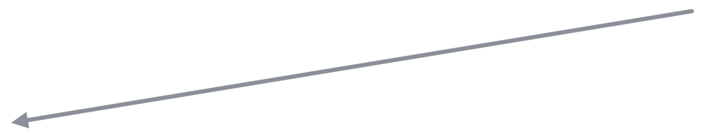

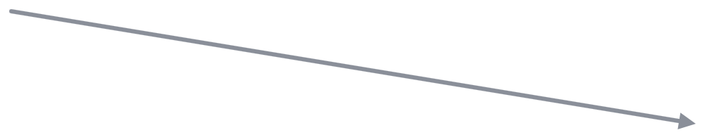

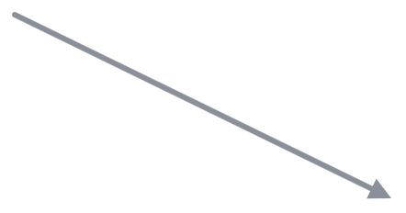
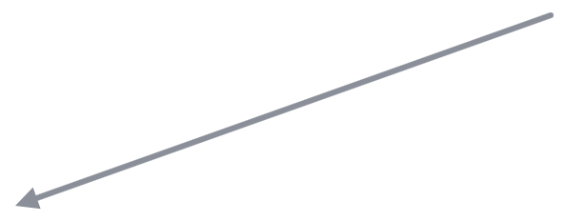

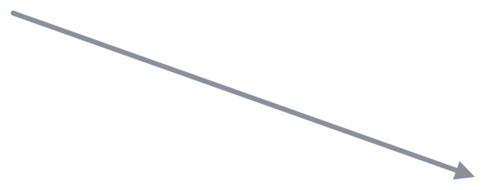
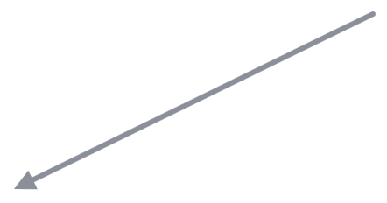

One goal, a few questions, many metrics
WORKSHOP · THE MODEL
Goal
G · one NFR
what we want
object · purpose · quality · viewpoint
Questions
Q1
Q2
Q3
what we must know
value: high
value: high
value: medium
Metrics
M1
M2
M3
M4
M5
which data answers
have · low
have · low
collect · high
have · med
collect · med
Define top-down, interpret bottom-up. Shared metrics are normal: M2 and M4 each answer two questions. Dashed = data you must collect.
Notes:
Questions carry value (how much the answer tells you about the goal); metrics carry cost (whether the data exists, and what collecting it would take). Selection in step 4 trades one against the other: Q1 and Q2 are high value and mostly cheap, so they are strong candidates. Q3 depends partly on M5, which must be collected, so it may wait.

Slide 12
WORKSHOP · EXAMPLE
Goal: Analyse the order API for the purpose of improving it with respect to response time from the viewpoint of end users in the context of peak-season traffic.
Question | Value | Metric | Source | Data · cost | Pick?
Q1 How fast is it now, normal vs. peak? | High | p95 latency per endpoint | APM tool | Have · low | Yes
Q2 Where is the time spent? | High | Database query time | Slow-query log | Have · low | Yes
Q2 (continued) | High | Latency per service hop | Tracing (to add) | Collect · high | Later
Q3 Does it slow down as data grows? | Medium | Latency vs. table size | APM + DB stats | Have · med | Maybe
Q4 Do users notice the delay? | Medium | Checkout abandonment | Web analytics | Have · low | Yes
Q4 (continued) | Medium | Perceived-speed rating | User survey | Collect · med | No
Pick = high-value question + cheap data. Hypothesis to test: p95 during peak is above [___ ms].
Notes:
Leave this slide up while groups work. Point out three things: one question can need several metrics (Q2, Q4); the same question gets a cheap answer now and a better, costly one later (tracing); and a medium-value question can still be picked if its data is free (Q4 via analytics).

